Slide 1
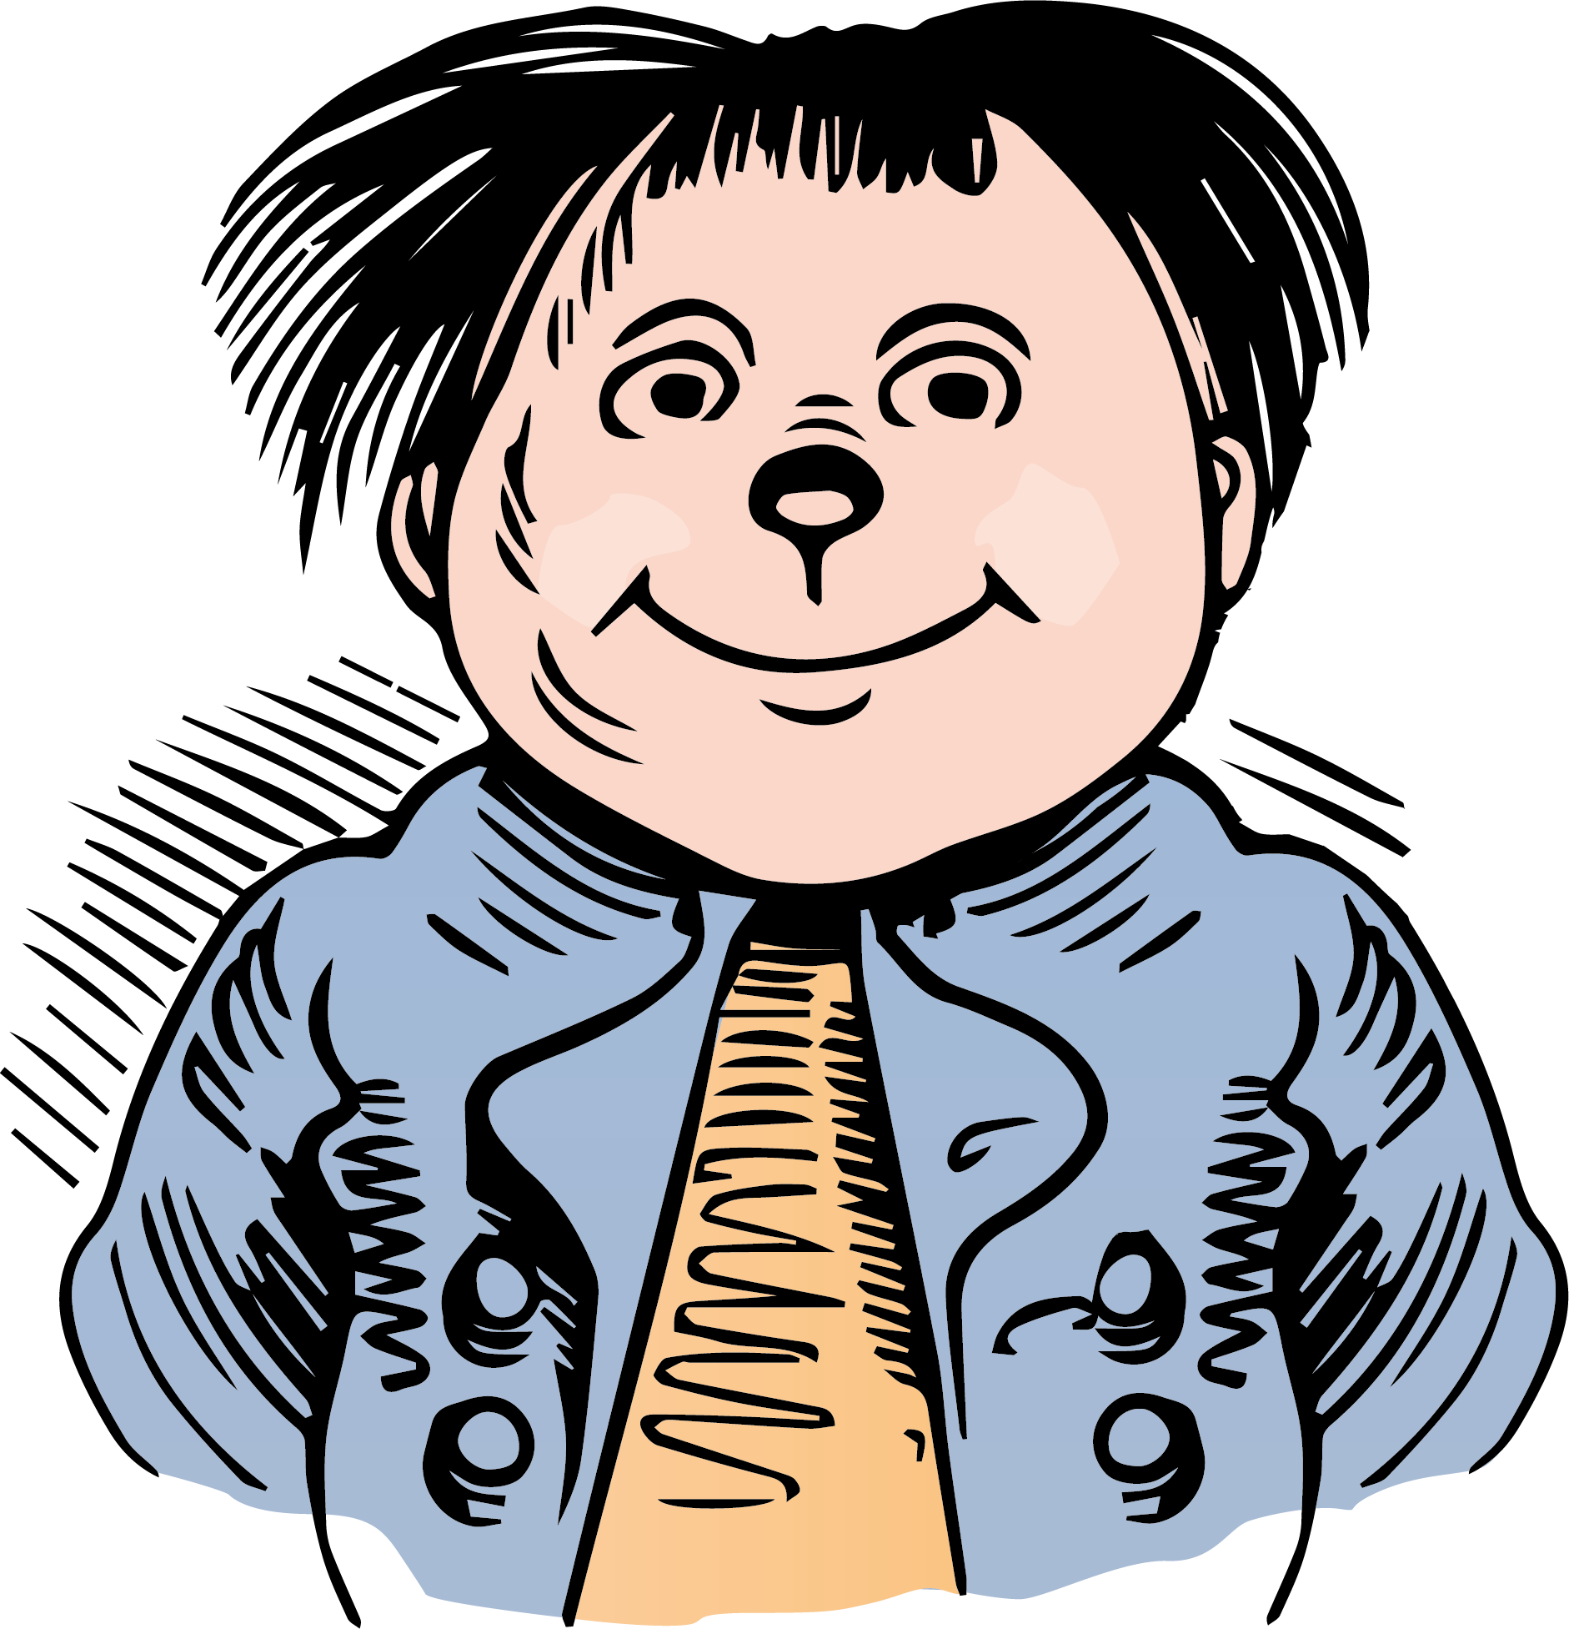
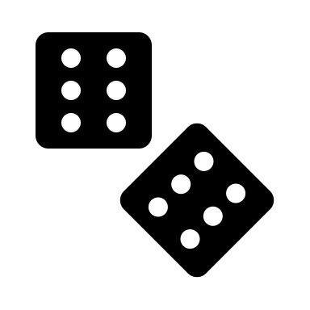
Mr. Mäxchen
Classic German drinking game
Thomas Schweers
[German, 29 years old and ]

Slide 2
Project “Mr. Mäxchen”
Game description
Coding a traditional German drinking game known as „Maiern“ / „Mäxchen“ / LYING / 21
No dices, no dice cup and no beer coaster?
-> Go for Mr. Mäxchen and have fun with your friends
REASON FOR
THE GAME
Mr. Mäxchen

Slide 3
What is “Mr. Mäxchen”?
Game description
Coding a traditional German drinking game known as „Maiern“ / „Mäxchen“ / LYING / 21
No dices, no dice cup and no beer coaster?
-> Go for Mr. Mäxchen and have fun with your friends
REASON FOR
THE GAME
Mr. Mäxchen

Slide 4


How to play “Mr. Mäxchen”?
Minimum of 3 Player around a table – no maximum of people
Play with one device, the device will be handed over to the next person
Play clockwise
In each step you have to choice between saying the truth or lying
But your number must be higher than the previous number
ORDER OF NUMBERS
31 < 32 < 41 < 42 < 43 < 51 < 52 < 53 < 54 < 61 < 62 < 63 < 64 < 65 < 11 < 22 < 33 < 44 < 55 < 66 < 21
SPEZIAL „MÄXCHEN“
21 -> Game is over everybody has to take a drink, espect of the one how get the “Mäxchen“
Mr. Mäxchen

Slide 5
Technical challenge
Identify the needed components like turns, safe numbers and order of functions
Knowing basics of OOP -> whole game in one class
Understanding of the basics of DOM Manipulation
Find the right order of steps (calling the right methods)
LEARNINGS
DEMO

Slide 6
Mistakes & Learnings
Mistaks
LEARNINGS
Create a new array for each turn
Safe to much information
Sometimes it is not necessary to store a historical values
Try to keep it clean and easy within the first line of code
BUT start also you do not have the whole idea – keep on developing

Slide 7
Have fun
&
Take some drinks
https://t4ms.github.io/06Project1-Maexchen/

Slide 8
Mr. Mäxchen
GAME „Mr. Mäxchen“
Player 1
Player 2
Player 3
When number is higher than the
When number is higher than the
Say previous player is lying
Say previous player is lying
num1 ≠ num1ly -> Player 1 is drinking
num2 ≠ num2 -> Player 2 is drinking
0>num1 -> Player 2 is drinking
0<num1 -> Player 1 is drinking
num1>num2 -> Player 3 is drinking
num1<num2 -> Player 2 is drinking
Take number
Take number
Take number
Lying – give a number
Lying – give a number
Lying – give a number
Roll dice again
and say higher
Roll dice again
and say higher
Roll dice again
and say higher
Example
random
num1
take
num1
random
num2
take
num3
num3
Lying option => Player 2 had to take a drink
43
43
31
53

Slide 9
Mr. Mäxchen
GAME „Mr. Mäxchen“
To-Do´s:
Set up the number order
Random dice outcomes
Order the random numbers of dice in the right outcome
Set up a class with player number (maybe only update the the figures)

